Slide 1
Big Game Census Analytics

Slide 2
Introduction
The Big Game Census Dashboard offers an in-depth analysis of player demographics and team compositions across major football teams. This dashboard enables teams, analysts, and fans to explore player attributes, including age, position, and birthplace, along with metrics specific to each team. By utilizing this data, stakeholders can gain valuable insights into player profiles and team dynamics, essential for strategic planning, player recruitment, and performance evaluation.

Slide 3
Details of Data
1. Data Overview:
Source: The dataset contains player data from two major football teams, New England and Philadelphia.
Attributes: Includes player age, jersey number, position, birthplace, and birth state.
Geographic Scope: Players’ birthplaces cover various U.S. states, with some international locations as well.
2. Key Variables:
Player Age: Records players' ages, averaging at 26.72 years.
Player Weight: Includes weight data, with an average of 243.88 lbs.
Player Position: Covers multiple positions such as WR, QB, RB, TE, and various defensive roles.

Slide 4
Details of Data(CONT.)
3. Data Segmentation:
Teams: Data is categorized by team, focusing on New England and Philadelphia.
Birth State: Analyzes players' birth states, highlighting prominent states like California, Texas, and Florida.

Slide 5
Main KPIs
Average Player Age: Indicates the average age of players, useful for evaluating team experience and longevity.
Player Weight Distribution: Highlights the weight distribution among players, possibly relevant to position or performance.
Years of Experience (Years Played): Reflects the average playing experience across the team.
Player Positions Count: Shows the count of players by position, indicating the composition of the team by role.
Player Distribution by Birth State: Identifies geographic diversity, showing states with higher player representation.
Average Birthplace Latitude and Longitude: Averages the geographic origin of players, offering insights into regional recruitment trends.
Team Representation: Counts players by team, revealing the most represented teams in the dataset.
College Representation: Shows the number of players from each college, useful for tracking player pipelines from different institutions.
City Population Influence: Examines the population sizes of players' birthplaces, which could correlate with talent distribution.

Slide 6
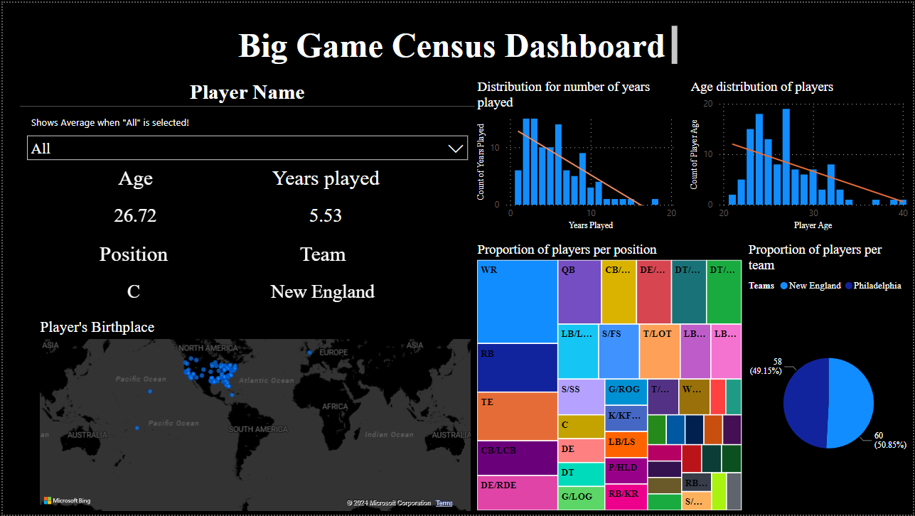
Dashboard

Slide 7
Thank you

